Slide 1

QUIZ TIME

Slide 2
JEOPARDY

Slide 3
ICU CARE
VENTILATION
ORGAN SYSTEMS
DRUGS
ATRIAL FIBRILLATION
5
5
5
5
5
10
10
10
10
10
15
15
15
15
15
20
20
20
20
20
25
25
25
25
25

Slide 4
ICU CARE
What fluid is used as the flush for arterial and central venous lines?

Slide 5
ICU CARE
0.9% Sodium Chloride or Heparinised Saline

Slide 6
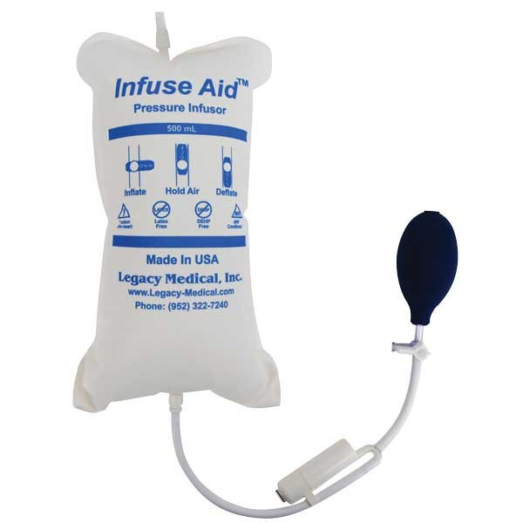
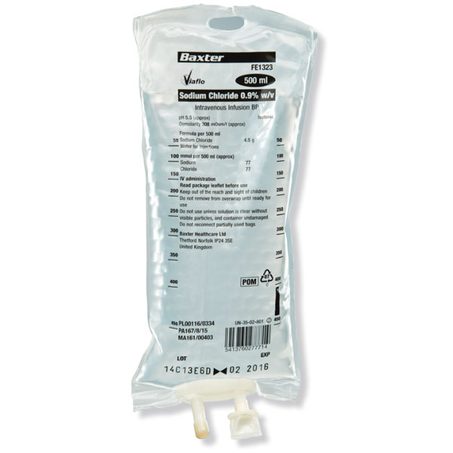
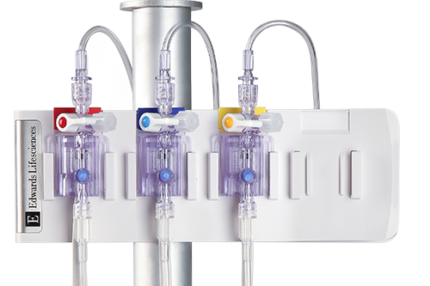
ICU CARE

Slide 7
ICU CARE
What is a LocSSIP?
Name one commonly used on ICU.

Slide 8
ICU CARE
Local Safety Standards for Invasive Procedures
CVL insertion

Slide 9
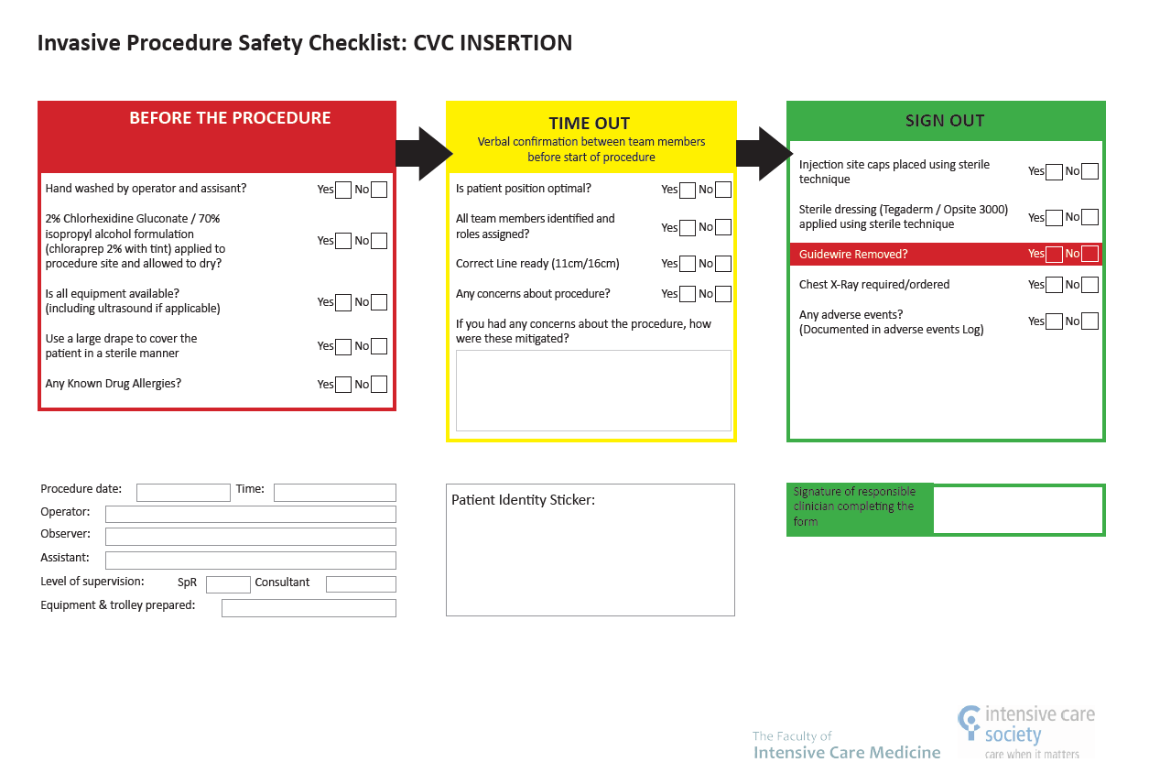
ICU CARE

Slide 10
ICU CARE
What is a Bundle?
Name two commonly used on ICU.

Slide 11
ICU CARE
A group of interventions related to a disease process that, when executed together, result in better outcomes than when implemented individually
VAP and Central Line Bundles

Slide 12
ICU CARE
VAP
1. Sedation holds
2. Suitability for weaning and extubation
3. Nurse >30° head up
4. Chlorhexidine mouth care
5. Subglottic suction
CVL
1. Checklist
2. Glove / gown / mask / Chlorhexidine
3. Catheter Site Selection
4. Skin Antisepsis
5. Dressing

Slide 13
ICU CARE
What is double pumping?

Slide 14
ICU CARE
“Where one infusion is substituted for another without interrupting the flow of the drug to the patient”.

Slide 15
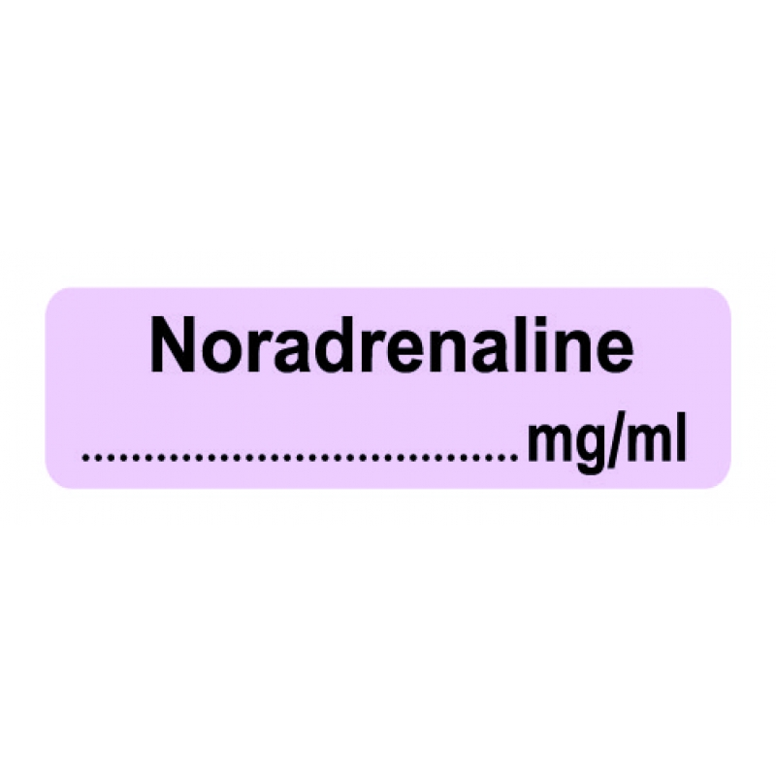
ICU CARE
Notes:
Emergencies: severe hypo/hypertension, bradycardia

Slide 16
ICU CARE
Five steps to confirm the correct placement of an NG tube on CXR?
Notes:
Confirm XR patient, time and date
Descends the thorax in midline
Bisects carina or main bronchi
Pass in midline and crosses diaphragm
Tip in LUQ below diaphragm

Slide 17
ICU CARE
Confirm CXR is for correct patient, time and date
Descends the thorax in the midline
Bisects carina or main bronchi
Pass in midline and crosses diaphragm
Tip is seen below diaphragm (on left)
Notes:
Confirm XR patient, time and date
Descends the thorax in midline
Bisects carina or main bronchi
Pass in midline and crosses diaphragm
Tip in LUQ below diaphragm

Slide 18
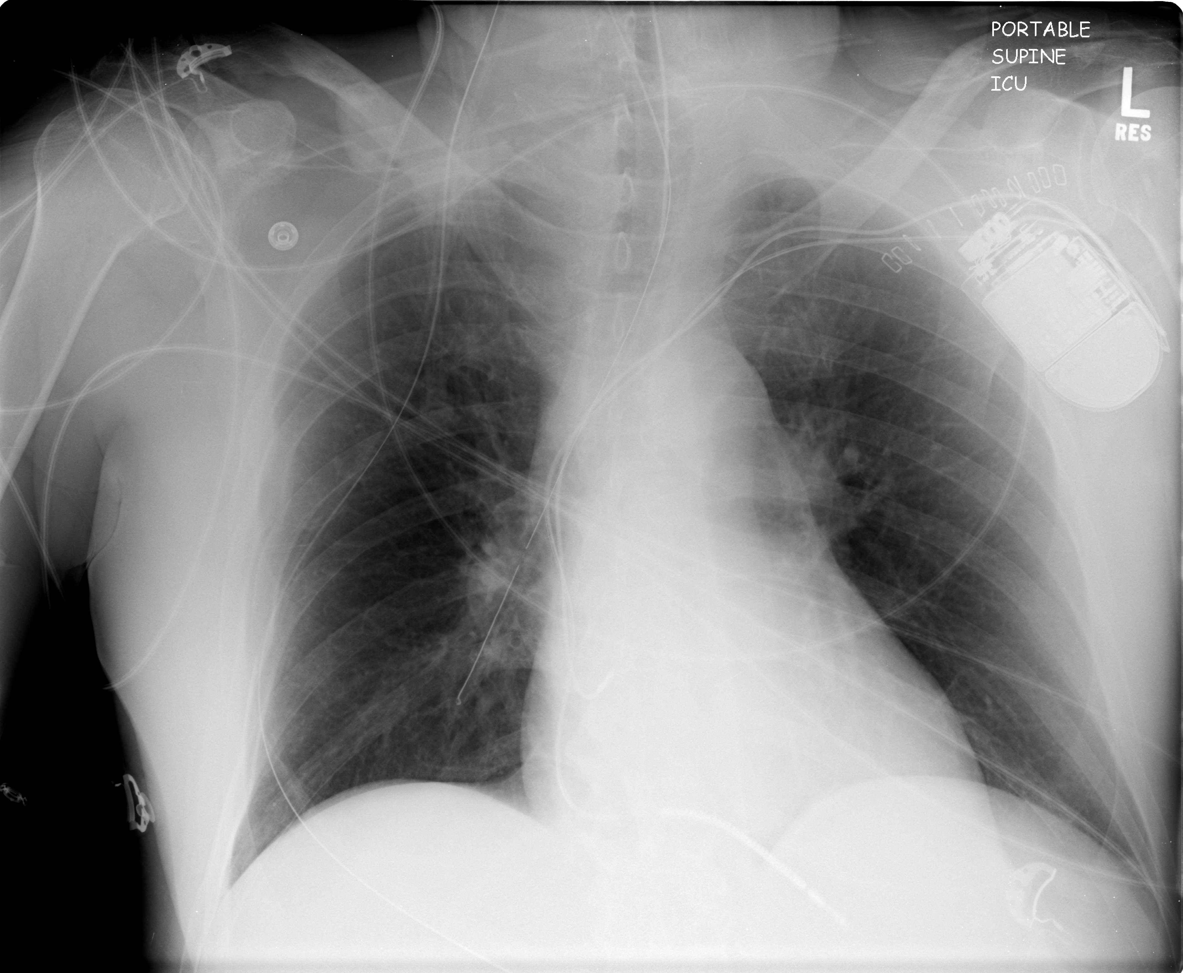
ICU CARE
Notes:
Confirm XR patient, time and date
Descends the thorax in midline
Bisects carina or main bronchi
Pass in midline and crosses diaphragm
Tip in LUQ below diaphragm

Slide 19
VENTILATION
Which drugs should you consider preparing for
emergency intubation?

Slide 20
VENTILATION
Ketamine
Propofol
Fentanyl / Alfentanil
Rocuronium
Metaraminol
Adrenaline 1:1000 and 1:10000

Slide 21
VENTILATION
How would you increase oxygenation in an intubated patient?

Slide 22
VENTILATION
If SV:Ensure sedation and paralysis appropriate
Increase FiO2
Treat any underlying cause
Increase mean airway pressure
Increase PEEP
Prone ventilation
ECMO
Notes:
If SV: sit up, deep breathe, cough etc
Ensure sedation and paralysis appropriate
Treat any underlying cause
Increase FiO2
Increase mean airway pressure
Increase PEEP
Prone ventilation
ECMO

Slide 23
VENTILATION
How would you set up a ventilator for an intubated patient post laparotomy, IBW 70kg?

Slide 24
VENTILATION
Mode: VC / PC / PRVC
VT 420mls
PEEP 6-8
RR 15-20/min
I:E 1:2
FiO2 0.5

Slide 25
VENTILATION
List five complications of mechanical ventilation

Slide 26
VENTILATION
Airway damage or loss
Excess force: volutrauma, barotrauma, atelectotrauma, biotrauma
Oxygen toxicity
VAP
Deranged acid base
Haemodynamic instability
Sedation related
Muscle weakness

Slide 27
VENTILATION
List four complications of prone ventilation

Slide 28
VENTILATION
ETT displacement/obstuction
Difficult/malfunctioning IV access
Oedema/pressure sores
Retinal or conjunctival changes
Nerve compression
Haemodynamic instability

Slide 29
ORGAN SYSTEMS
List five reasons to commence renal replacement therapy on ICU
Notes:
Fluid overload
Acidosis
Hyperkalaemia
Uraemia
Other toxins
AS part of clinical course

Slide 30
ORGAN SYSTEMS
Acidosis not responsive to medical therapy
Fluid overload not responsive to medical therapy
Hyperkalaemia not responsive to medical therapy
Symptomatic Uraemia
Other toxins
As part of anticipated clinical course
Notes:
Fluid overload
Acidosis
Hyperkalaemia
Uraemia
Other toxins
AS part of clinical course

Slide 31
ORGAN SYSTEMS
What is Sepsis?
List the five components of the SSC Hour-1 Sepsis Bundle
Notes:
Sepsis
Sepsis is defined as life–threatening organ dysfunction due to a dysregulated host response to infection.
Organ dysfunction is represented by an increase SOFA score of 2 or more points, associated with an in-hospital mortality greater than 10%
Septic Shock
Septic shock is defined as a subset of sepsis where underlying circulatory and cellular/metabolic abnormalities are profound enough to substantially increase mortality.
Patients with septic shock can be clinically identified by a vasopressor requirement to maintain a mean arterial pressure of 65 mm Hg or greater and serum lactate level greater than 2 mmol/L (>18 mg/dL) in the absence of hypovolemia.
SSC Hour-1 Bundle of Care Elements (October 2019):
• Measure lactate level*
* Remeasure lactate if initial lactate is elevated (> 2 mmol/L).
• Obtain blood cultures before administering antibiotics.
• Administer broad-spectrum antibiotics.
• Begin rapid administration of 30mL/kg crystalloid for hypotension or lactate level ≥ 4 mmol/L.
• Apply vasopressors if hypotensive during or after fluid resuscitation to maintain MAP ≥ 65 mm Hg.

Slide 32
ORGAN SYSTEMS
Sepsis: life–threatening organ dysfunction due to a dysregulated host response to infection (increase SOFA score ≥ 2 (mortality ≥10%)
Septic Shock: where underlying circulatory and cellular/metabolic abnormalities are profound enough to substantially increase mortality.
Lactate (and remeasure)
Blood cultures before administering antibiotics
Broad-spectrum antibiotics
30mL/kg crystalloid for hypotension or lactate ≥ 4 mmol/L
Vasopressors if hypotensive during or after fluid resuscitation to maintain MAP ≥ 65 mm Hg
Notes:
Sepsis
Sepsis is defined as life–threatening organ dysfunction due to a dysregulated host response to infection.
Organ dysfunction is represented by an increase SOFA score of 2 or more points, associated with an in-hospital mortality greater than 10%
Septic Shock
Septic shock is defined as a subset of sepsis where underlying circulatory and cellular/metabolic abnormalities are profound enough to substantially increase mortality.
Patients with septic shock can be clinically identified by a vasopressor requirement to maintain a mean arterial pressure of 65 mm Hg or greater and serum lactate level greater than 2 mmol/L (>18 mg/dL) in the absence of hypovolemia.
SSC Hour-1 Bundle of Care Elements (October 2019):
• Measure lactate level*
* Remeasure lactate if initial lactate is elevated (> 2 mmol/L).
• Obtain blood cultures before administering antibiotics.
• Administer broad-spectrum antibiotics.
• Begin rapid administration of 30mL/kg crystalloid for hypotension or lactate level ≥ 4 mmol/L.
• Apply vasopressors if hypotensive during or after fluid resuscitation to maintain MAP ≥ 65 mm Hg.

Slide 33
ORGAN SYSTEMS
What is ARDS?

Slide 34
ORGAN SYSTEMS
A syndrome characterized by acute inflammatory process affecting the lungs
Berlin Definition (2012) based on:
Timing
Presence of bilateral opacities on CXR/CT
Origin of oedema
Moderate to severe hypoxia
Notes:
Murray Score: P:F, CXR quadrants, PEEP, compliance

Slide 35
ORGAN SYSTEMS
List immediate priorities in initial management
of patient with TBI

Slide 36
ORGAN SYSTEMS
A: intubate
B: LPV, oxygenate PaO2>13 kPa, ventilate PaCO2 4.5-5 kPa
C: maintain CPP (CPP = MAP – ICP)
D: sedate
CT Scan and transfer to area of definitive care

Slide 37
ORGAN SYSTEMS
What are the features of rhabdomyolysis in an ICU patient?

Slide 38
ORGAN SYSTEMS
Clinical suspicion
Muscle pain and paraesthesia
Hyperkalaemia, (hyperuracaemia, hyperphosphataemia)
High lactate and acidosis
AKI
Raised CK
Myoglobinuria
Coagulopathy
Notes:
Rhabdomyolysis is characterized by breakdown of skeletal muscle with the release of myoglobin and other intercellular proteins and electrolytes into the circulation.
Traumatic (crush, immobilization) vs exertional (Spin!) vs non-traumatic: ETOH, drug use, NMS, infection, DKA

Slide 39
DRUGS
List three adverse effects of Propofol

Slide 40
DRUGS
Hypotension
Respiratory Depression
Unconsciousness
High calorie load
Propofol Infusion Syndrome

Slide 41
DRUGS
Rare but life-threatening
>48 hours of >4mg/kg/hr
Metabolic acidosis
Rhabdomyolysis,
Bradyarrythmias
Cardiac arrest
Notes:
70kg patient: >280mg/hr (28/14mls)
Impaired fa metabolism inhibits mitochondrial function, leading to impaired O2 utilisation

Slide 42
DRUGS
Which Noradrenaline dose is higher?
0.2mcg/kg/min in 60kg patient
or
8ml/hr single strength in 90kg patient

Slide 43
DRUGS
0.2mcg/kg/min in 60kg patient
= 9ml/hr single strength
8ml/hr single strength in 90kg patient
= 0.12mcg/kg/min
Notes:
SS 4mg/50 ml = 80mcg/ml, DS 8mg/50ml = 160mcg/ml, QS 16mg/50ml = 320mcg/ml
mcg/kg/min to ml/hr (SS)
mcg x kg = mcg/min
x 60 = mcg/hr
/80 = ml/hr SS
ml/hr (SS) to mcg/kg/min
ml/hr x 80 = mcg/hr
/60 = mcg/min
/kg = mcg/kg/min

Slide 44
DRUGS
Which opioids are used for sedation in ICU?

Slide 45
DRUGS
Alfentanil
Remifentanil
Morphine

Slide 46
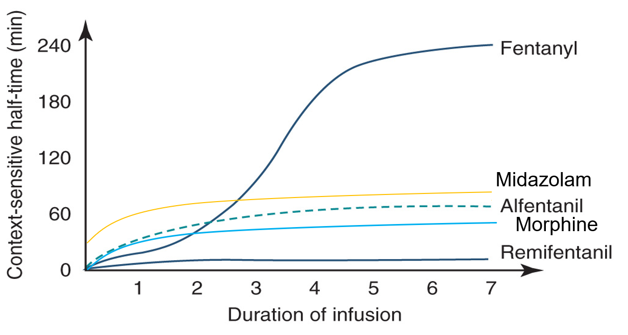
DRUGS
Notes:
Propofol between Alfentanil and Remifentanil

Slide 47
DRUGS
Match drug to primary mechanism of action
Noradrenaline Increase contractility
Milrinone Ca sensitizer
Vasopressin Inodilator
Dobutamine Vasoconstriction
Levosimendan Increase contractility
Adrenaline Vasoconstriction

Slide 48
DRUGS
Match drug to mechanism of action
Noradrenaline Vasoconstriction
Milrinone Inodilator Ca sensitizer
Vasopressin Vasoconstriction
Dobutamine Increase contractility
Levosimendan Ca sensitizer
Adrenaline Increase contractility

Slide 49
DRUGS
Who am I? And how do you spell my name?
I am given as an infusion
I do no affect your respiratory function
I can provide sedation and anxiolysis
I am an α2 agonist

Slide 50
DRUGS
D E X M E D E T O M I D I N E

Slide 51
ATRIAL FIBRILLATION
List four common causes of AF in an ICU patient
Notes:
Electrolyte imbalance
Hypoxia
Infection/sepsis
Anaemia
Cardiac arrest/surgery

Slide 52
ATRIAL FIBRILLATION
Electrolyte imbalance
Hypoxia
Infection/sepsis
Anaemia
Cardiac arrest/surgery
Intra-thoracic surgery
Notes:
Electrolyte imbalance
Hypoxia
Infection/sepsis
Anaemia
Cardiac arrest/surgery

Slide 53
ATRIAL FIBRILLATION
List four unstable features of AF
Notes:
Chest pain
Tachypnoea
Decreased LOC
Heart Failure
Hypotension

Slide 54
ATRIAL FIBRILLATION
Chest pain
Tachypnoea
Decreased LOC
Heart Failure
Hypotension
Notes:
Chest pain
Tachypnoea
Decreased LOC
Heart Failure
Hypotension

Slide 55
ATRIAL FIBRILLATION
List four potential pharmacological management options for AF
Notes:
Amiodarone
Beta blockers
Calcium channel blockers
Digoxin

Slide 56
ATRIAL FIBRILLATION
Amiodarone
Beta blockers
Calcium channel blockers
Digoxin
Magnesium
Notes:
Amiodarone
Beta blockers
Calcium channel blockers
Digoxin

Slide 57
ATRIAL FIBRILLATION
List four uses of Magnesium
Notes:
Bronchospasm
AF
Other dysryhtmias
Pain
Pre-eclampsia
Laryngoscopy
Hypertension in phaeo storms

Slide 58
ATRIAL FIBRILLATION
Laryngoscopy
Bronchospasm
AF
Hypertension in phaeo storms
Other dysrhythmias
Pain
Pre-eclampsia
Notes:
Bronchospasm
AF
Other dysryhtmias
Pain
Pre-eclampsia
Laryngoscopy
Hypertension in phaeo storms

Slide 59
ATRIAL FIBRILLATION
What factors should you consider before commencing anticoagulation for ICU patient with AF?
Notes:
Indication
Length of having it
CHADS2VASC
Need for DCCV
Pathology
AKI/renal function
Surgical or practical procedures to be performed
Which drug – short acting reversible

Slide 60
ATRIAL FIBRILLATION
Duration of AF
Need for DCCV
CHADS2VASC
AKI/renal function
Surgical or practical procedures to be performed
Which drug – short acting reversible
Notes:
Likely attributable to reversible, non-cardiac disease - only 15% patients remain in AF at discharge…hypoxia….electrolytes…sepsis
More likely to adversely affect haemodynamics etc
AF may be a secondary marker of severity of disease process
AF less likely to cause death from stroke
AF more likely to cause MOF/dysfunction
Anticoagulation for AF is typically delayed ( usually have higher bleed risk eg post op)
No ‘best pharmacotherapy’ option , at 12 hours cardioversion rates are:
Amiodarone 40-76%
Esmolol/flecainide 60%-100%
Magnesium 51-93%

Slide 61
THANKS FOR PLAYING

