Slide 1
The Multi-Consultant Report Form (MCRF)
Dr A Sharman
Lead Regional Advisor, FICM

Slide 2
Multiple Consultant Report Form
Purpose
  Coffee room chat
  Useful feedback for resident - good and bad
  Educational Supervisor aid if not worked with resident
Developed 2021
  Used all other forms and took the best bits
  4 + educationalist - got more PC….
Released and refined from feedback
Now version 5 – but we still require feedback

Slide 3
The purpose expanded
Wanted a clinical feedback tool to help residents develop
First 4 HiLLO’s are often trouble areas that cause issues later
  Wanted earlier intervention
  Help to develop clinical skills well - early
Educational Supervisor often not working with resident and needed guidance - coffee room principle
NOT MSF - ours is trainer and clinically focused
Consultant in MCRF is a generalised term for senior recognised trainer

Slide 4
The form
Clear guidance on purpose and how to use it
Clear guidance on summary for Educational Supervisors

Slide 5
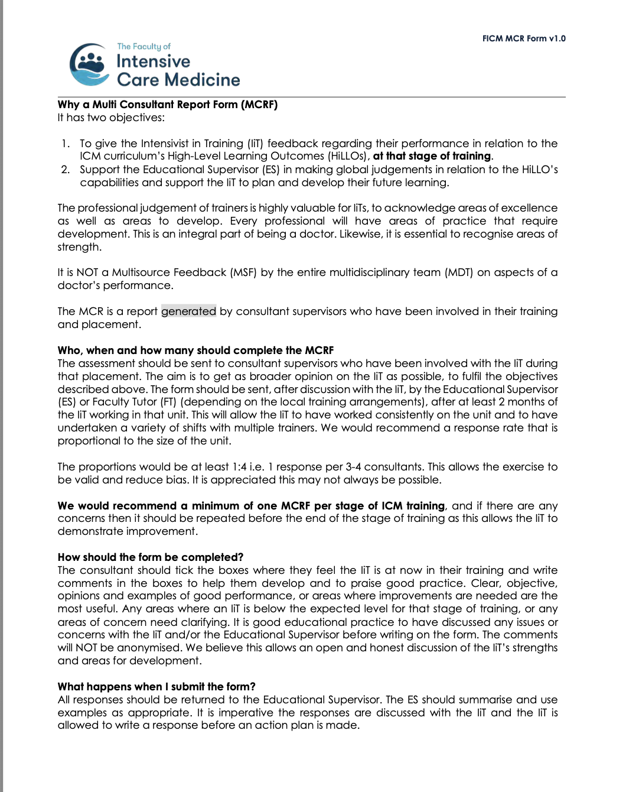

Slide 6
Key points for MCRF
All consultants in the dept receive the form
Minimum response -1 consultant per 3-4 consultants
No anonymised forms accepted - open culture
1 per stage - more if issues
Not mandatory yet

Slide 7
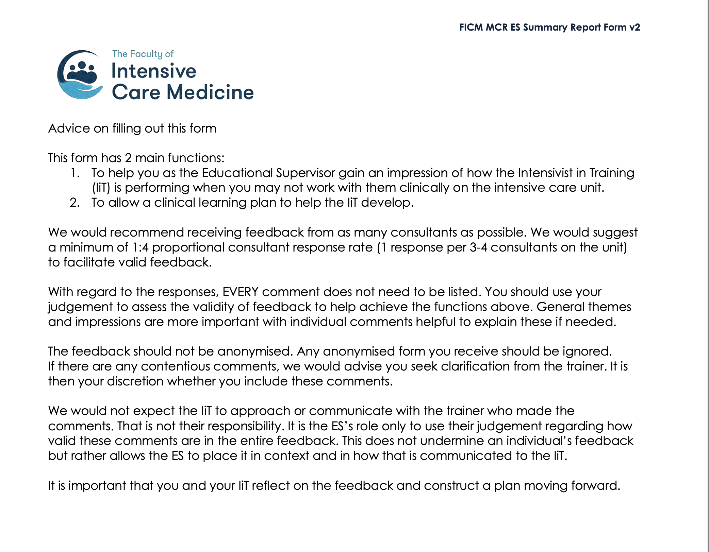
Summary
MCRF

Slide 8
Key points for Summary
Not all comments need to be copied and pasted - themes with examples a good idea
No anonymised comments included
Needs discussion with resident - response and plan agreed
Resident MUST NOT approach trainer re: comments

Slide 9
Good news…we have an electronic form!
Massive thanks to Dr Nicolas Plummer for his IT expertise with this
If you want any further help or to help develop other IT resources
he is happy to be contacted at: nickplummer@nhs.net

Slide 10
1. How to generate a MCR Form
Access/cut and paste/click on link
https://forms.office.com/Pages/ShareFormPage.aspx?id=HPDPU8ge8U6OAZO-sA6_cwmyB2H9Lt5JlHgJRsk5239UN0hBN0U5MFdaRURWUkFVQkRMV1c3UVVNUi4u&sharetoken=AIftAdwj27jNdWGIvyh8
You will need a Microsoft account

Slide 11
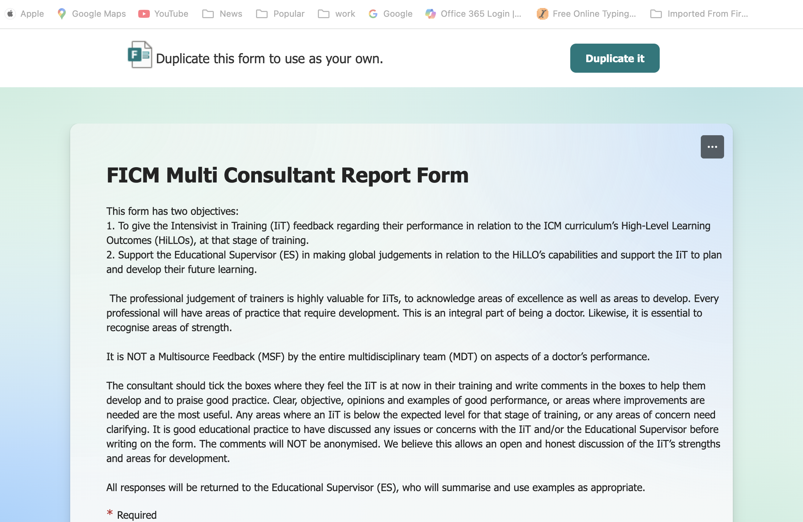
2. Duplicate the form

Slide 12
2. Duplicate form
Once you duplicate the form it will require you to log in (if you haven’t already) to a Microsoft environment. This is where the form data will be saved.
I use my nhs.net account or my School’s/personal account
This form will now be saved into your account within the Office environment, and accessible in future by going to https://forms.office.com/Pages/DesignPageV2.aspx (under "Recent" or "My forms")

Slide 13
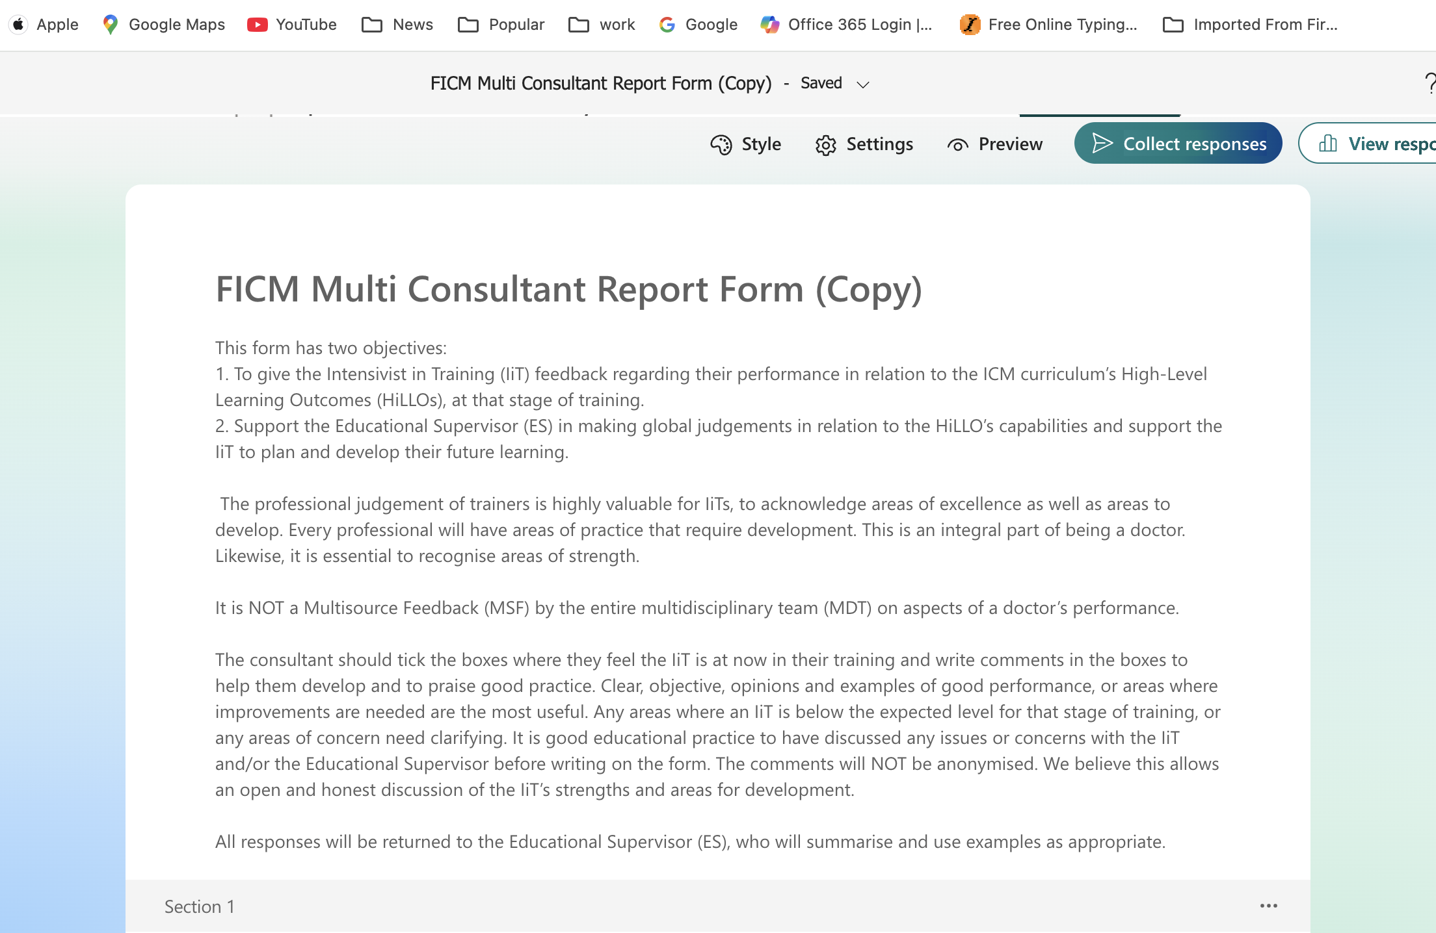
3. Name the form with resident’s initials
put initials

Slide 14
3a. Set survey response time
If you click on
Settings, you get
Option to enter
End date for resp.

Slide 15
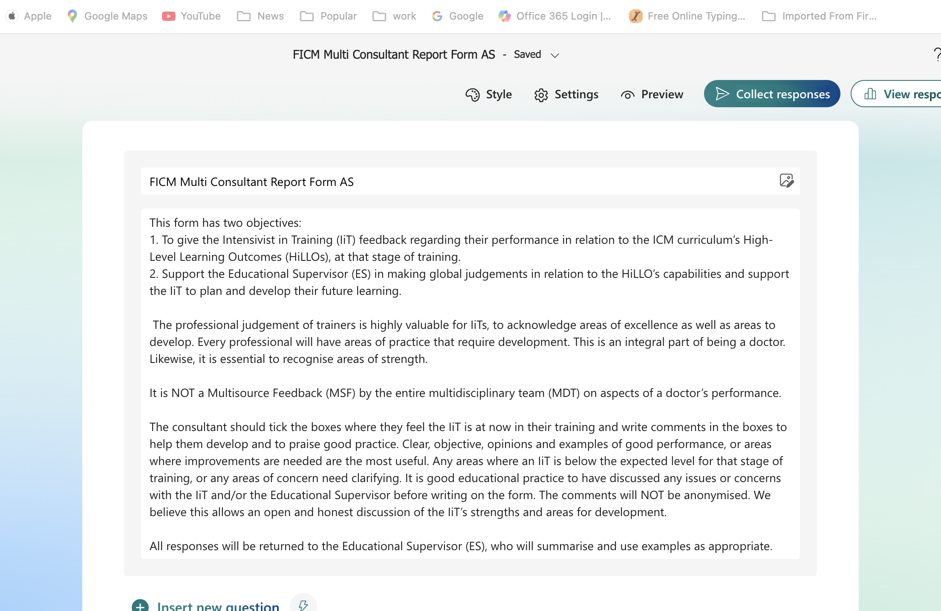
4. Collect Responses
Initials of IiT in form.
Now press collect responses

Slide 16
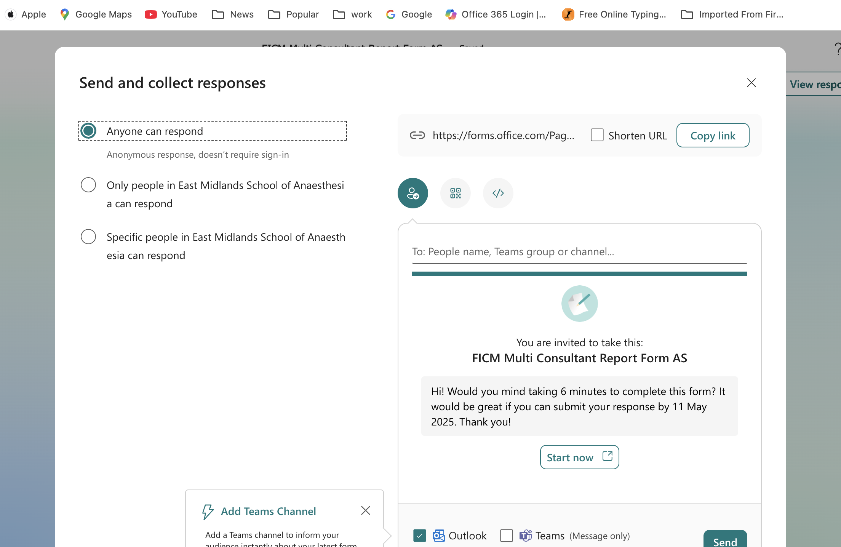
5. Setting responders
Change to ‘Anyone can respond’.
This allows those without an account to complete the Form

Slide 17
6a. How to send - link
Copy the link
and paste in an email to your consultant contacts

Slide 18
6b. How to send - email

Slide 19
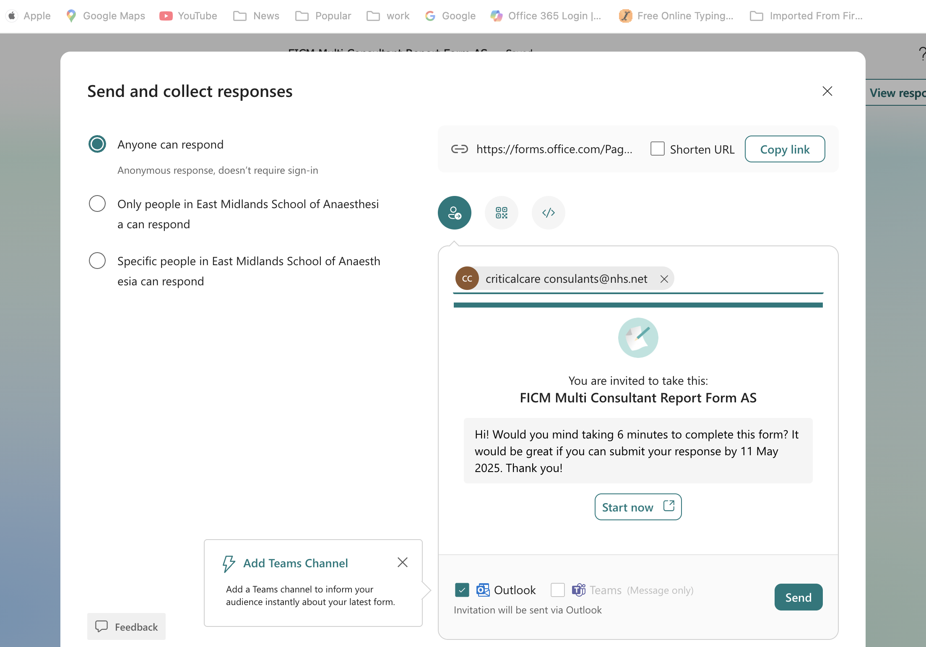

Slide 20
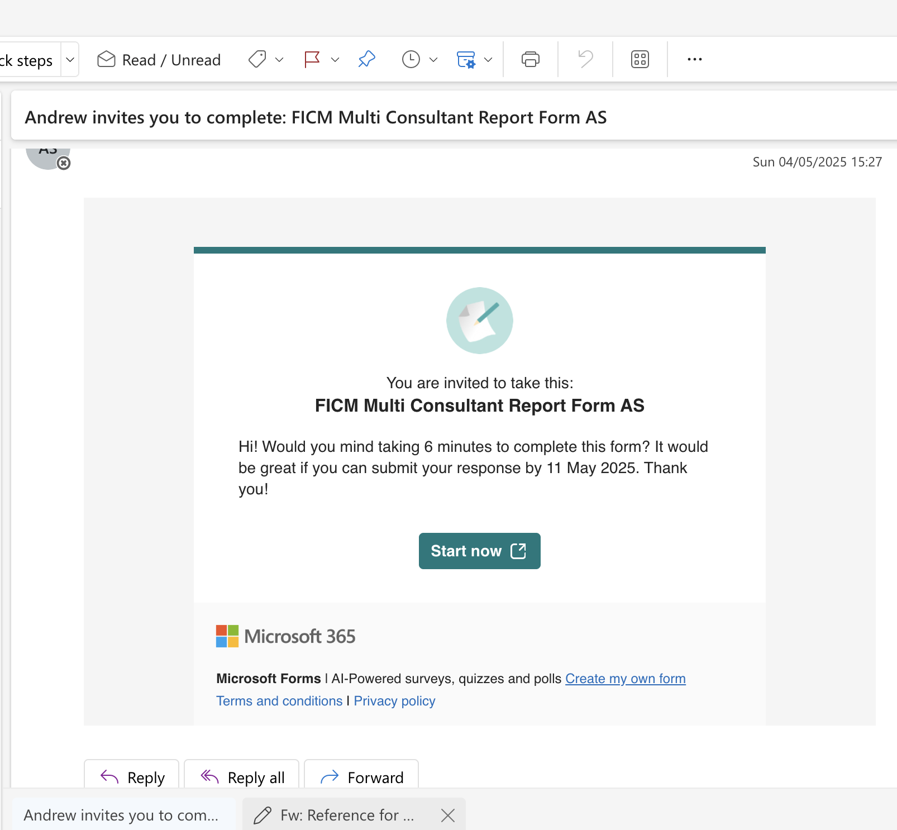
What a consultant receives

Slide 21
7. Consultant receiving form
Fill in resident’s name

Slide 22
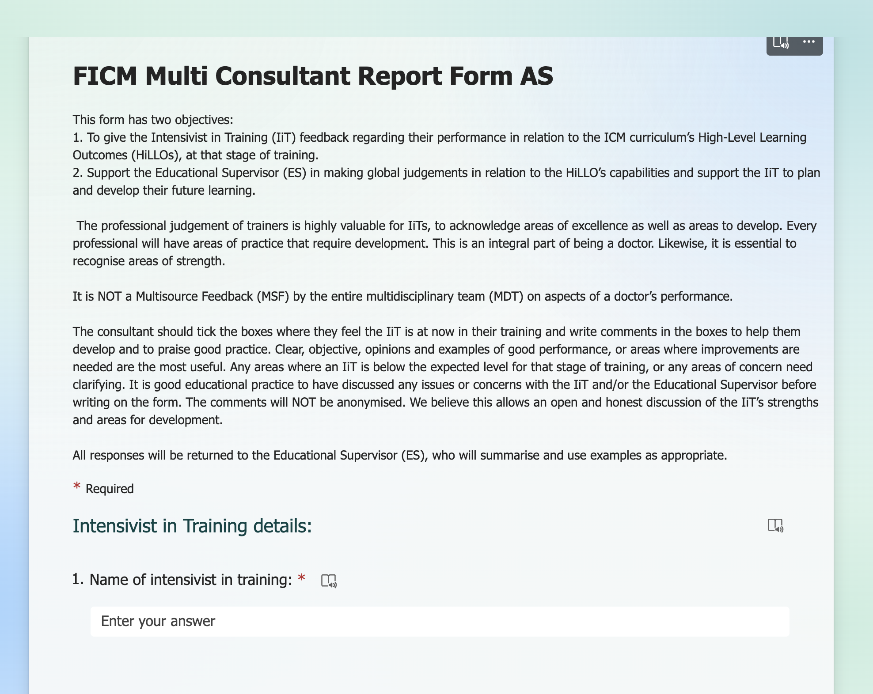
Add resident’s name

Slide 23
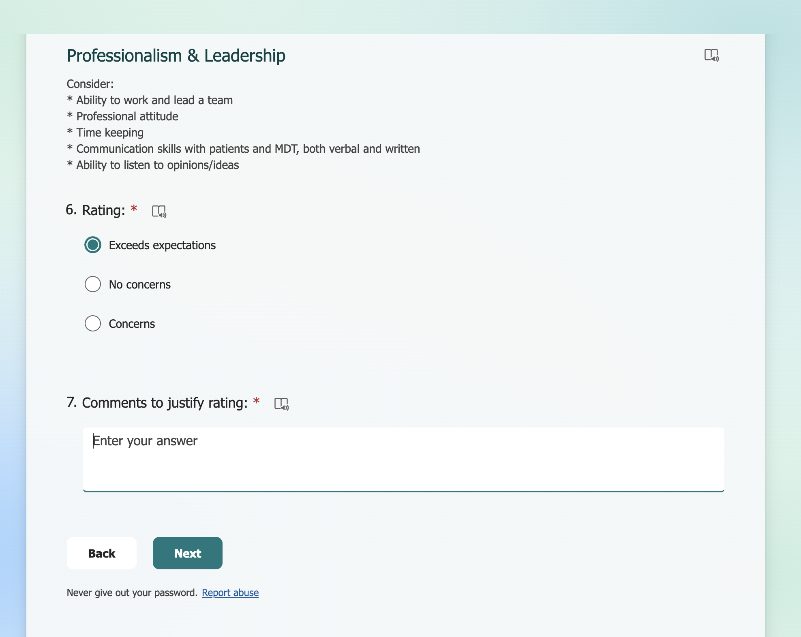
Consultant completes form
Add comment or full stop to move on

Slide 24
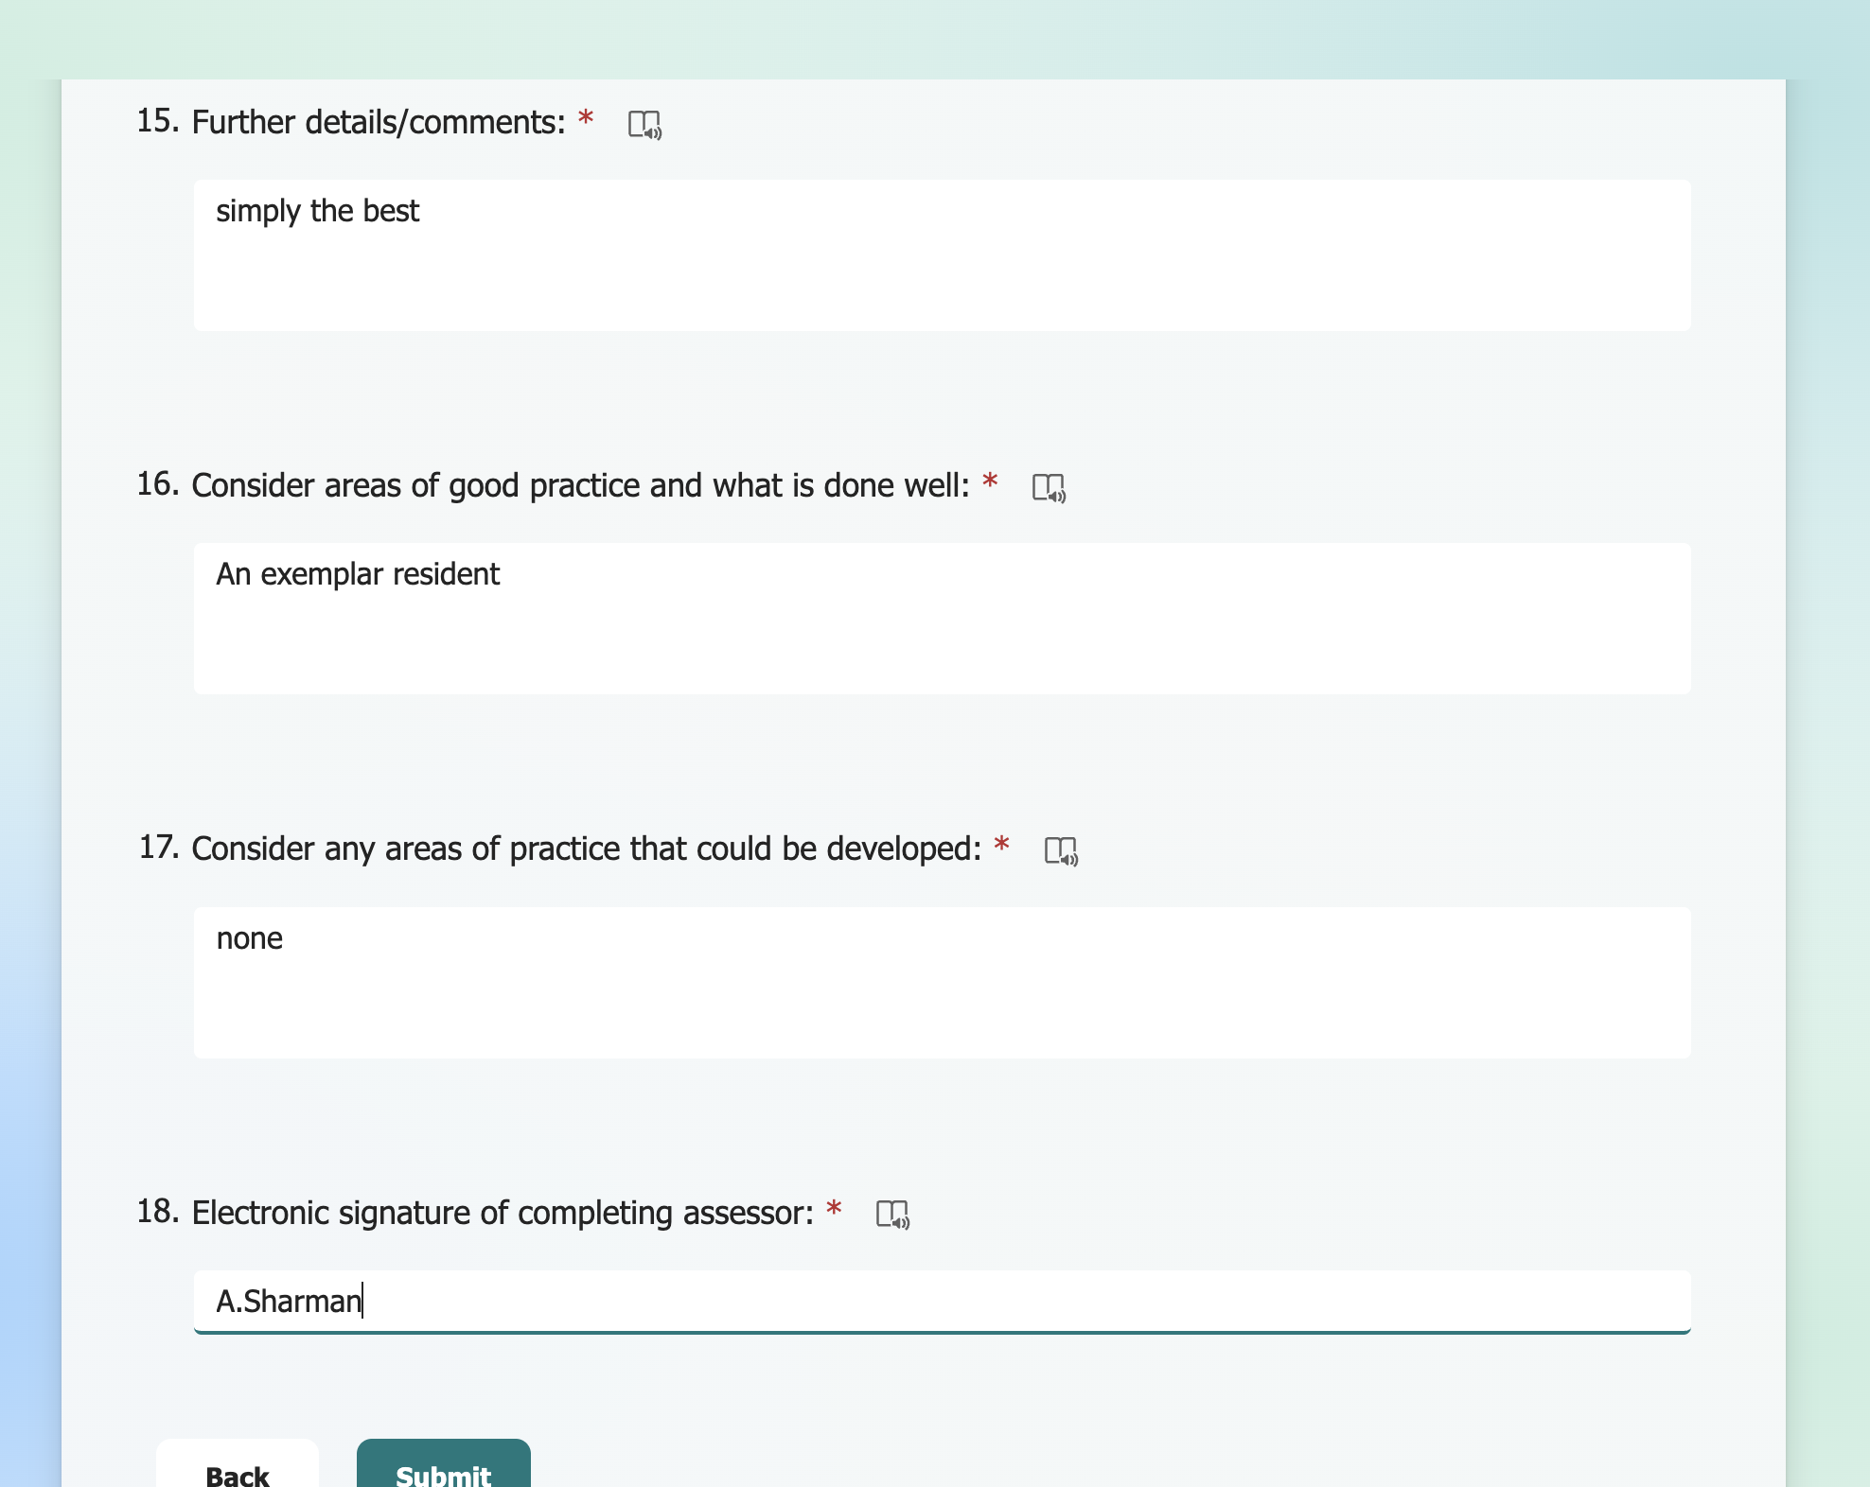
Submit

Slide 25
What the sender of the form gets back

Slide 26
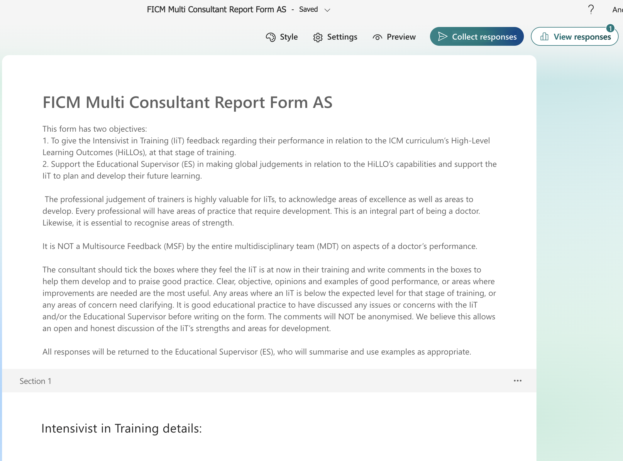
Reviewing responses

Slide 27
Responses
These come as an Excel file
Send this to the IiT’s Educational Supervisor

Slide 28
Final job as Faculty Tutor – delete the locally saved data of the current form

Slide 29
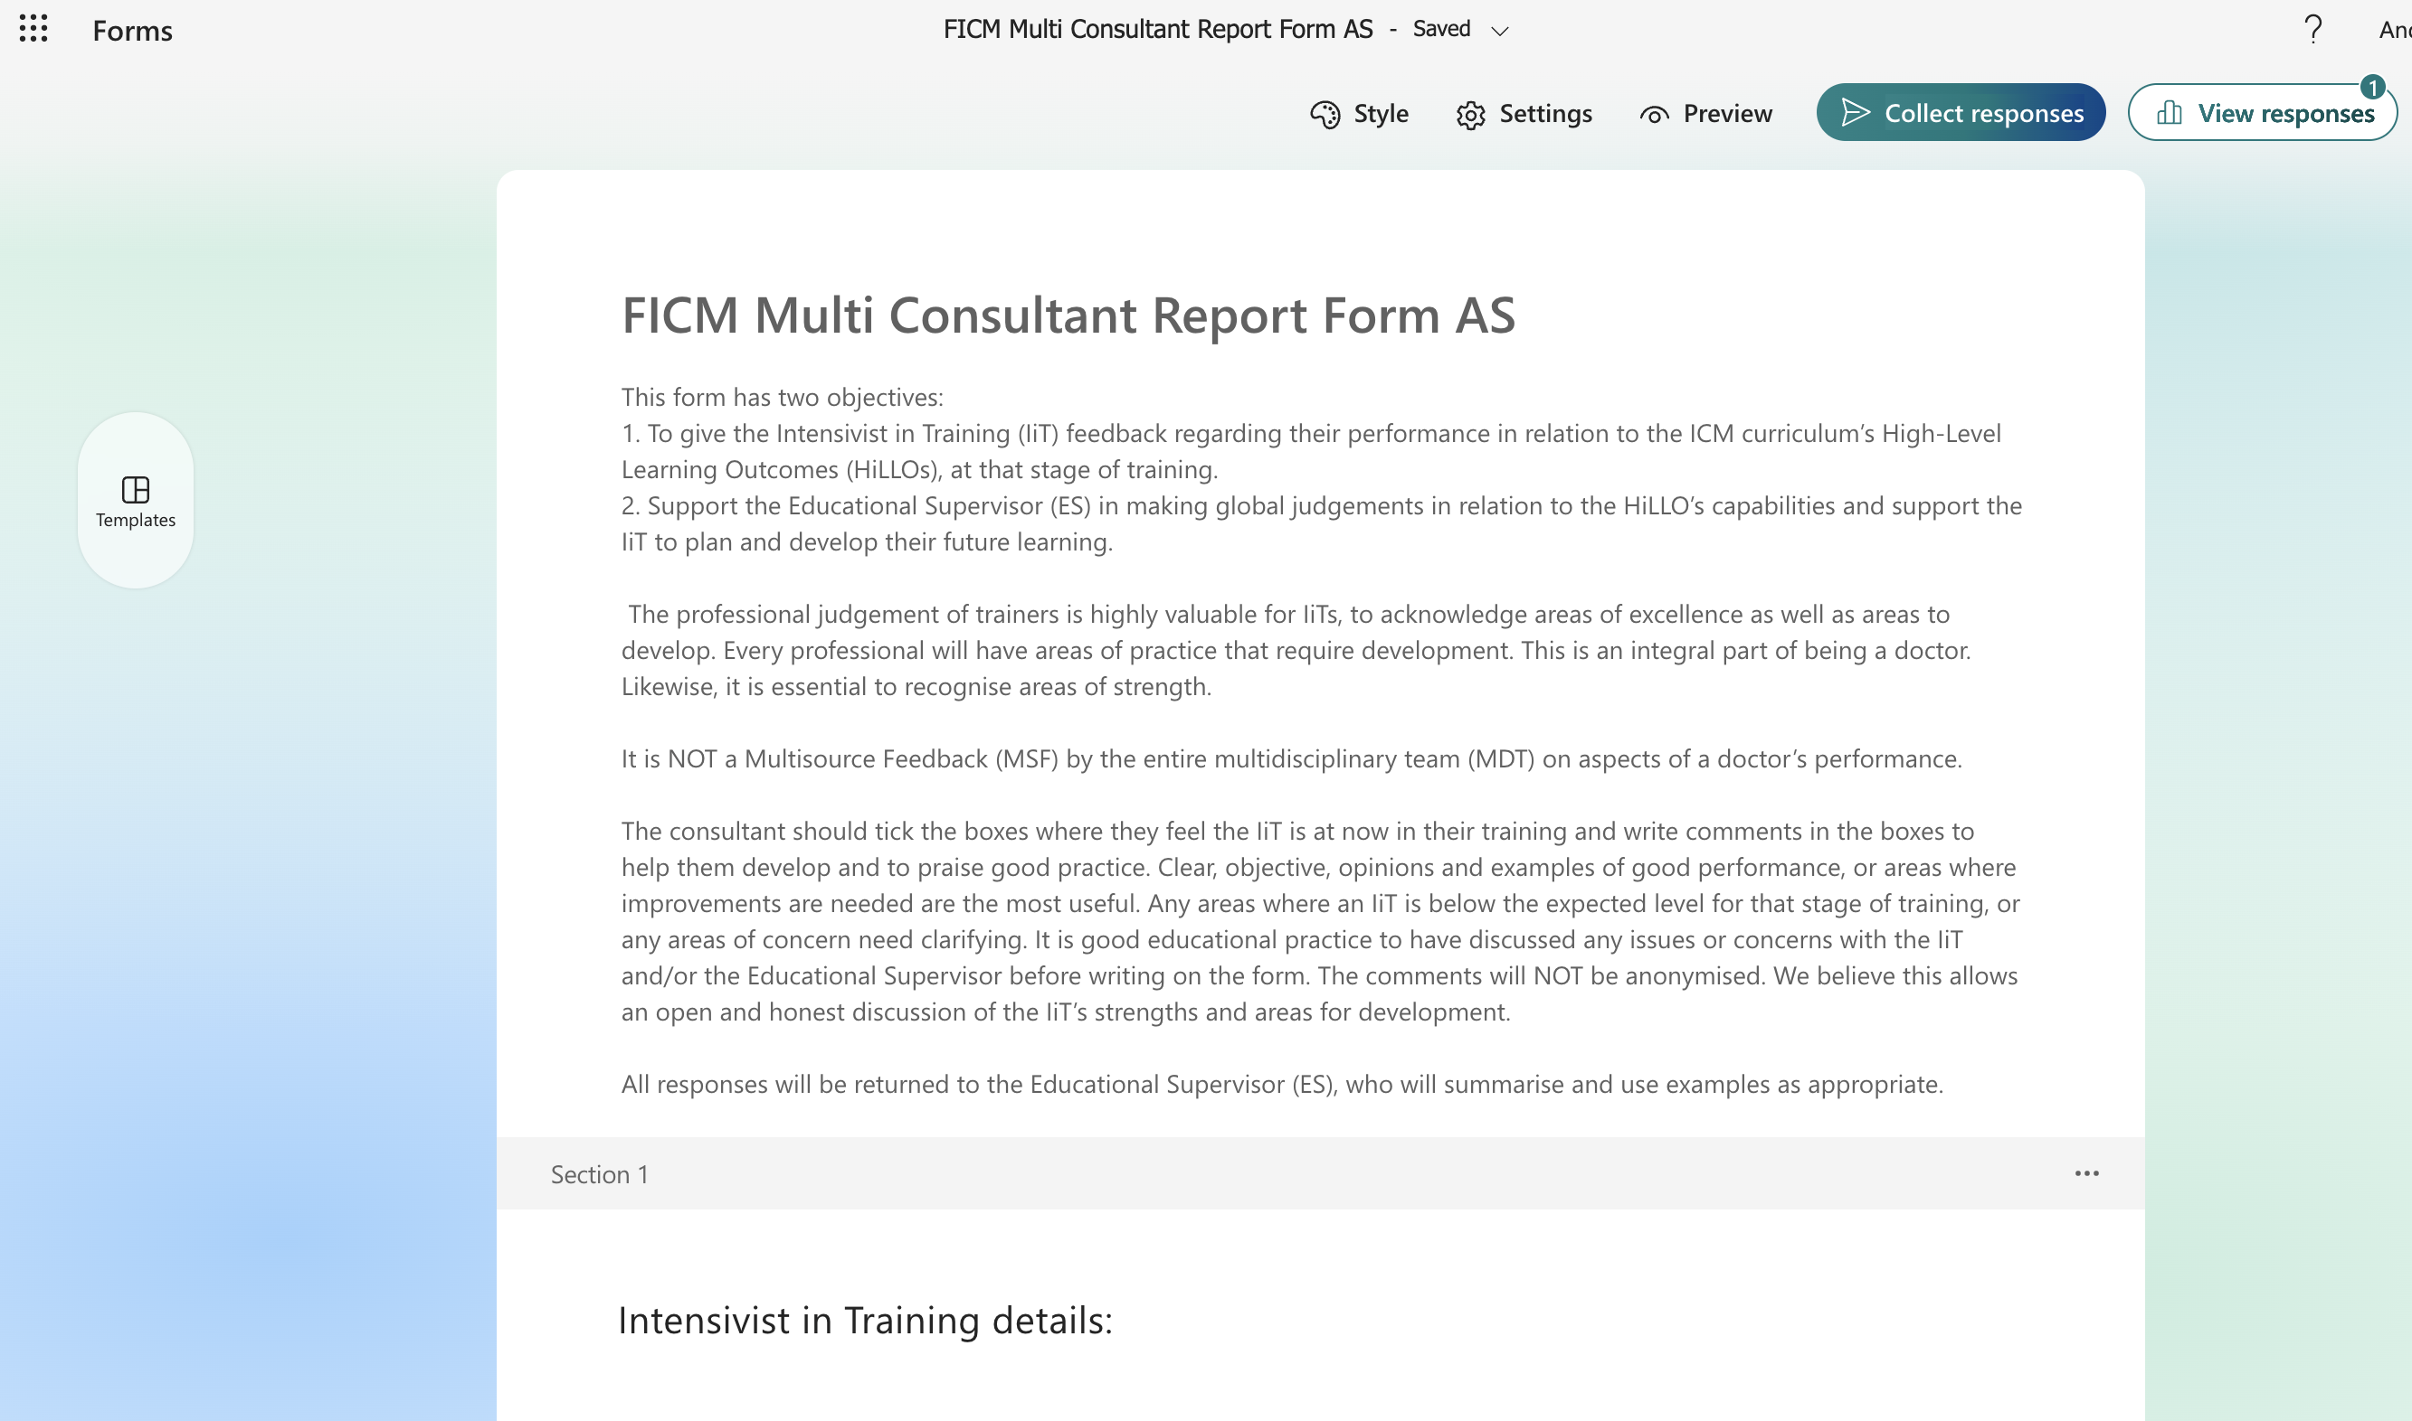
To delete the form, click on ‘Forms’ in the top left-hand corner

Slide 30
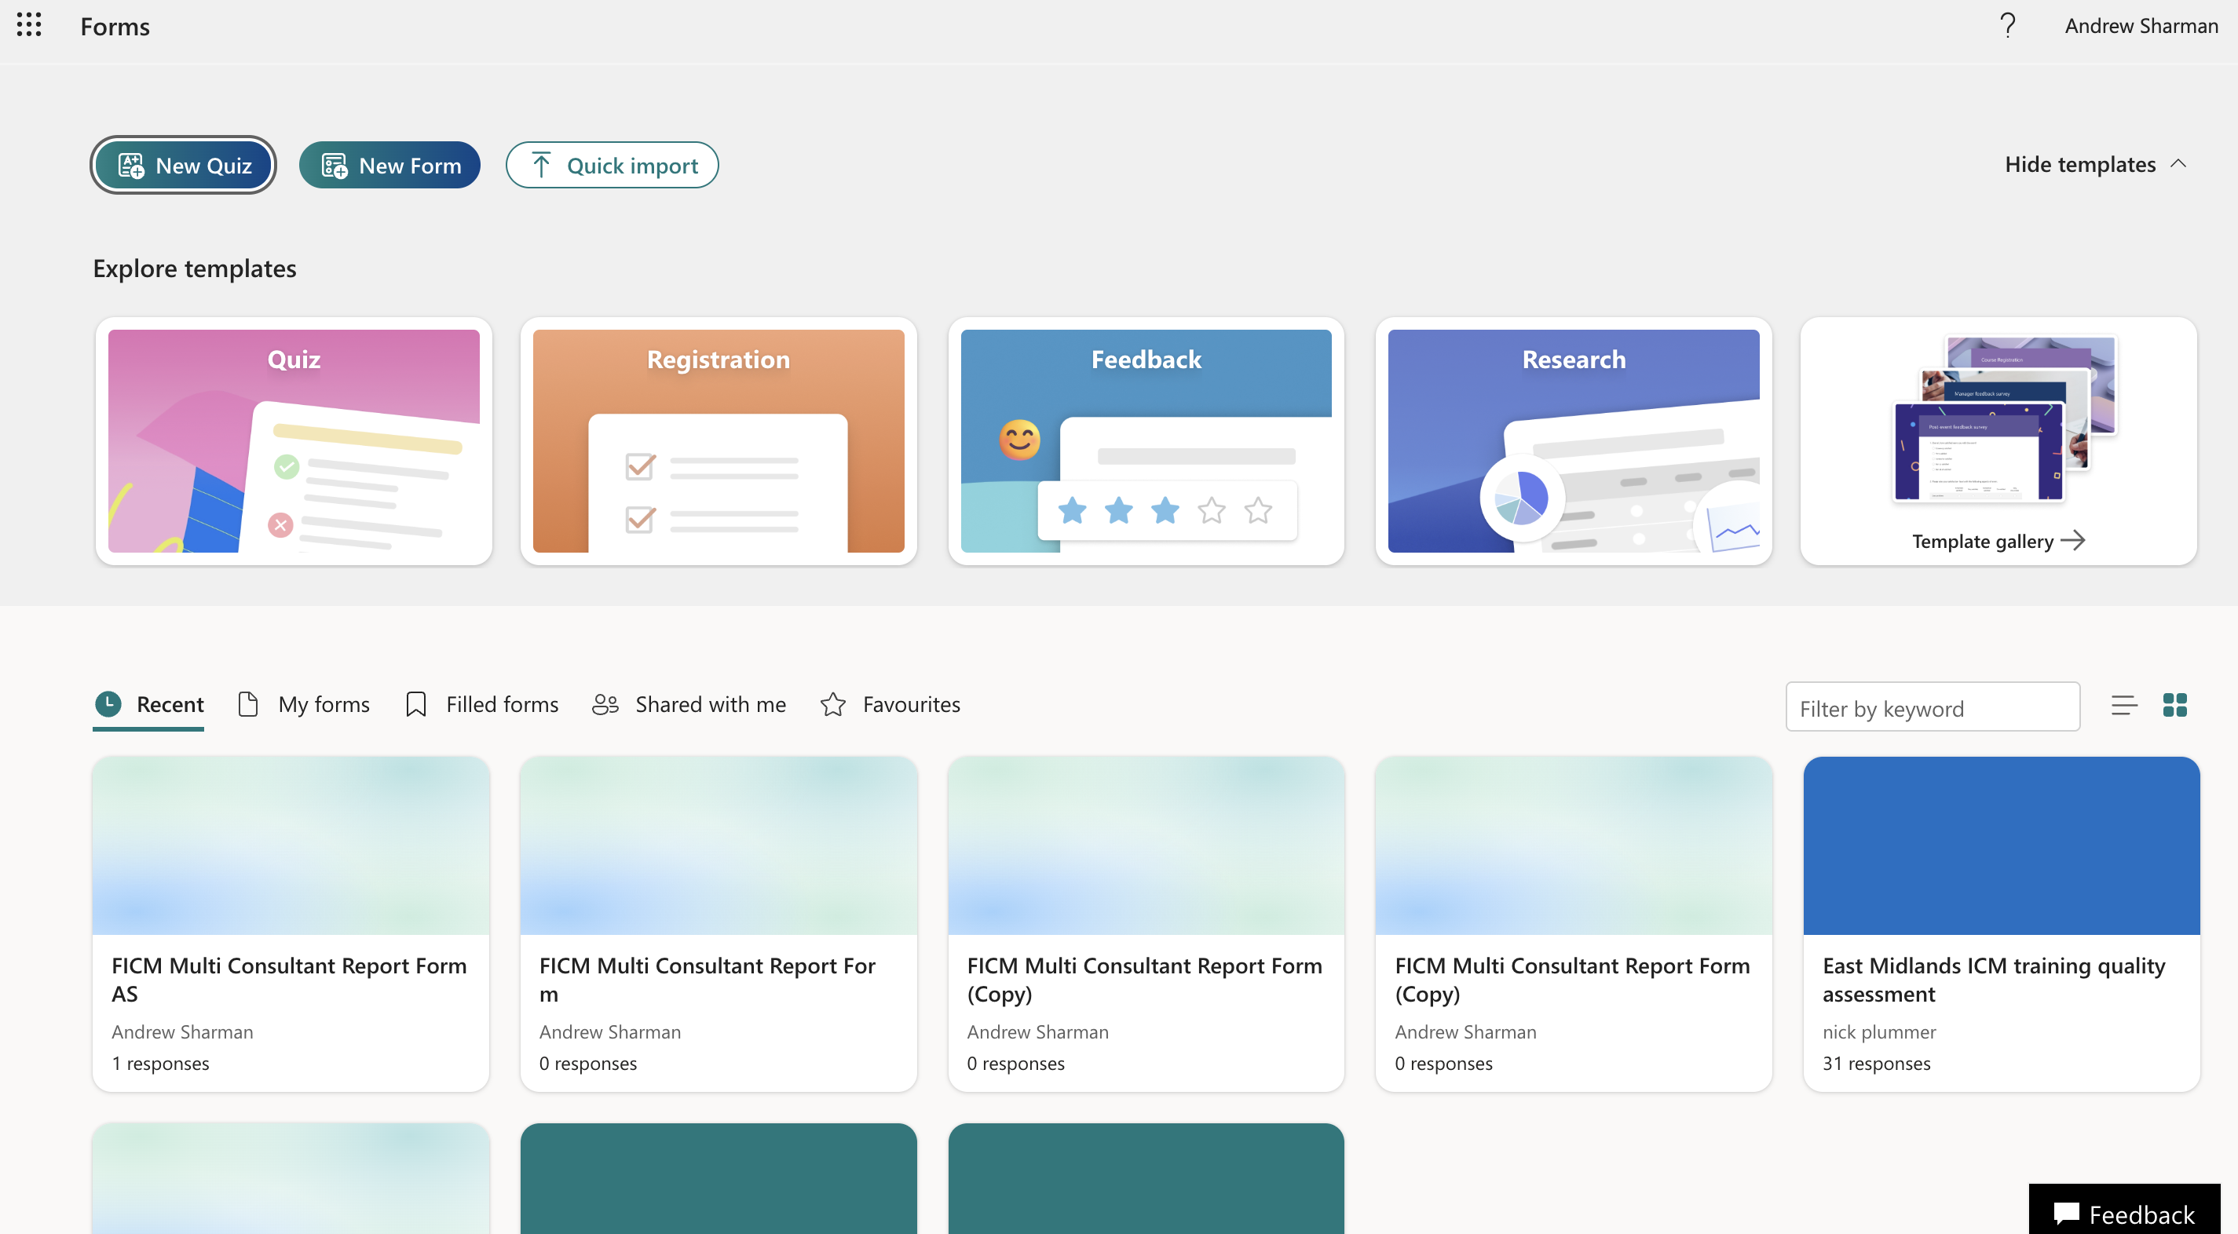
Then click the three dots (hover your mouse over the form) to display ‘more options’ - then please DELETE THE FORM!
…

Slide 31
The Educational Supervisor
Open Excel file
Cut and paste information to Summary MCR Form
Moderate responses as appropriate
Feedback to resident and discuss
Agree responses and write it on Summary MCRF
Save and resident uploads it to LLP.

Slide 32
Feedback
andrew.sharman1@nhs.net
contact@ficm.ac.uk

